Slide 1
Navigating HIPAA Regulations
Michelle C. Stickler, DEd
Director, Research Subjects Protections
mcstickler@vcu.edu
828-0131

Slide 2
Key Definitions
Covered Entity: Organization that handles identifiable health information AND participates in certain electronic transactions (e.g., payments, billing, claims, etc.)
VCU Affiliated Covered Entity (VCUACE): VCUHS and parts of VCU have combined for the purposes of compliance with the Privacy Act

Slide 3
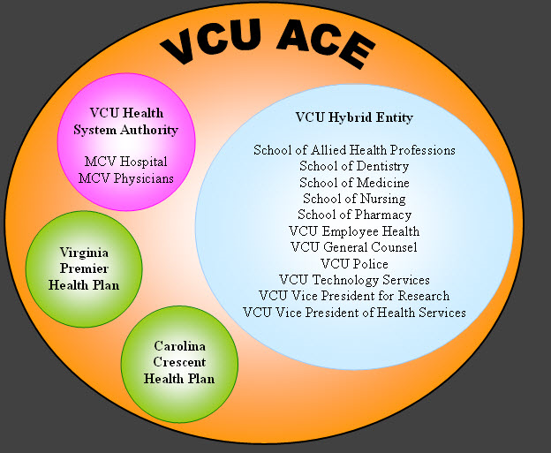
VCU Affiliated Covered Entity

Slide 4
Key Definitions
Protected Health Information (PHI): Individually identifiable health information that is obtained or used for treatment, payment or health care operations in a covered entity.
Research Related Health Information (RRHI): Health information that is identifiable AND obtained entirely for research purposes.
Notes:
NOTE: Health information collected and/or used as part of a treatment study becomes PHI.

Slide 5
Individually Identifiable Data
Any one of 18 identifiers make health information identifiable

Slide 6
HIPAA Identifiers
Names
All geographic subdivisions smaller than a state
Some exceptions for 1st 3 digits of zipcode
All elements of dates (except year) for dates directly related to an individual:
Birth date
Admission & discharge dates
Date of death
All ages over 89 and all elements of dates (including year) indicative of such age
Ages 90+ can be categorized into ≥90
Telephone numbers
Facsimile numbers
Electronic mail addresses
Social security numbers
Medical record numbers
Health plan beneficiary numbers
Account numbers
Certificate/license numbers
Vehicle identifiers and serial numbers, including license plate numbers
Device identifiers and serial numbers
Web universal resource locators (URLs)
Internet protocol (IP) address numbers
Biometric identifiers, including fingerprints and voiceprints
Full-face photographic images and any comparable images
Any other unique identifying number, characteristic, or code, unless otherwise permitted by the Privacy Rule for re-identification

Slide 7
Pathways to Access PHI for Research
De-identified data (none of 18 identifiers)
Review preparatory to research
Limited data set
Signed participant authorization
Partial waiver of authorization
Waiver of authorization
Research with decedents

Slide 8
De-identified Data
Any health information that does not contain any of the 18 identifiers
De-identified data is not subject to HIPAA regulations
Two methods of de-identification
Safe harbor (no identifiers)
Statistical analysis with attestation
If an identifier is present, a statistician can use accepted methods for analysis and certify that there is little likelihood of re-identification

Slide 9
De-Identified Data
Coded data
If all 18 identifiers are coded or removed and the individual cannot be reasonably identified – considered de-identified
Link field cannot be related to any identifiers
Researcher cannot maintain the key or code link

Slide 10
De-Identified Data & Approval
Submit IRB Appendix A - HIPAA with IRB application

Slide 11
Review Preparatory to Research
Used to review PHI for study feasibility
Not intended for collecting contact information for recruitment
May not remove PHI from the covered entity

Slide 12
Review Prep to Research Approval
Submit Review Prep form to ORSP for administrative approval
Expires 6 months after approval; may reapply

Slide 13
Limited Data Set
Excludes all identifiers EXCEPT:
Geographic information (city, state, zip but not street address)
Dates such as birth dates, admission dates, etc.
Other unique identifiers, not including the other 16 identifiers on the list
Encourage use when direct participant contact is not required and can get by with limited identifiers

Slide 14
Limited Data Set Approval
Submit with IRB application:
Appendix A – HIPAA
Data Use Agreement
IRB will approve use and signed data use agreement will be returned to PI
Applies to VCU / VCUHS researchers when accessing limited data set from VCU ACE

Slide 15
Signed Authorization
Required Elements:
Identify what PHI is being requested
Study specific
Who will release it
Who it be released to
Why/what you will do with it
Expiration (date or event)
Signature and date
Right to revoke
Cannot condition treatment on release but can refuse research unless access is authorized

Slide 16
Signed Authorization Approval
Submit:
Appendix A – HIPAA
Integrated ICF / Authorization OR Separate ICF / Authorization
Templates available
Biomedical ICF template includes authorization language option
Stand-alone HIPAA authorization template available on HIPAA guidance page

Slide 17
Partial Waiver of Authorization
Means waiving authorization to make initial contact, followed by signed authorization at time of enrollment
Used for review of PHI to collect information for recruitment purposes

Slide 18
Partial Waiver Approval
Submit with IRB application:
Appendix A – HIPAA
Integrated ICF / Authorization OR Separate ICF / Authorization

Slide 19
Waiver of Authorization or Elements
Used when obtaining signed authorization for use of PHI in study conduct is not practicable or feasible
Generally would apply when waiver of consent is appropriate

Slide 20
Waiver of Authorization Approval
Submit with IRB application:
Appendix A - HIPAA

Slide 21
Research on Decedents’ PHI
Unlike Common Rule, HIPAA regulations cover PHI of deceased individuals
Applies to studies accessing PHI of decedents ONLY
Does not apply if study will access PHI of both decedents and living individuals
IRB application will cover this situation

Slide 22
Research on Decedents Approval
Submit Research with Decedents form to ORSP for administrative approval
Does not require IRB approval

Slide 23
Accounting of Disclosures
Patients have a right to know to whom PHI has been disclosed
Applies when using:
Waiver of authorization
Disclosures required by law
Disclosures for public health purposes

Slide 24
Accounting of Disclosures
If you are conducting research with a waiver of authorization, you need to keep a record of any and all disclosures outside of research team
Names/lists
Dates of disclosures
To whom disclosure was made
Brief description of what was disclosed
Brief description of why disclosed
Retain records for a minimum of 6 years past study closure

Slide 25
Accounting of Disclosures
Modified Tracking Mechanism
50 or more participants (with waived authorization)
Do not need a list of each participant
Do need to record:
Name of protocol
Types of PHI disclosed
Dates of disclosure
Contact info for recipients
State that specific individual’s PHI may / may not have been disclosed

Slide 26
HIPAA Record Keeping
HIPAA authorizations and accounting of disclosure information must be maintained for 6 years past study closure

Slide 27
Security of PHI
Data Storage
Prevent unauthorized access
Do not leave computer or research folders unattended
Store in locked files or locked rooms (at all times)
Do not store in publicly accessible areas
Do not take home on unencrypted laptop
For more information on securing data via technology: http://www.medschool.vcu.edu/technology/infosecurity/

Slide 28
Security of PHI
Data Transfer
Electronic PHI transfer – securely encrypted
Make sure it goes to the right person
Make sure it remains secure until received
Ground mail
Send encrypted data (jump drives available from Office of Compliance)
Insured carrier
Receiving signature required
Package tracking service

Slide 29
Security of PHI
Data Destruction
Paper: dispose of by shredding
Electronic records
Must destroy with multiple overwrite steps to erase
Contact IT for assistance

Slide 30
Non-Compliance
Violation Category | Each Violation | All such violations of an identical provision in a calendar year
Did not know | $100-$50,000 | $1,500,000
Reasonable cause | $1,000-$50,000 | $1,500,000
Willful Neglect – Corrected | $10,000-$50,000 | $1,500,000
Willful Neglect – Not Corrected | $50,000 | $1,500,000

Slide 31
Non-Compliance Examples
$4.3 Million penalty to Cignet Health for denying patients’ access to their medical records and not cooperating with the investigation
$1 Million penalty to Massachusetts General for failing to implement appropriate safeguards to protect privacy of PHI
Uncovered via loss of unencrypted laptop containing sensitive data

Slide 32
Questions or Comments?

